Slide 1
Project Process Book
ADAM HARRIS
CIT 4450

Slide 2
Customer information
Advanced Learning Systems is a provider of learning management system (LMS) applications for primary, secondary, and collegiate institutions. Their products support student education though the process of using dynamic web-based applications. These applications have a range of features including delivery of curricula, student rostering, professional development for teachers, and integration with other online educational platforms.
Advanced Learning wishes to supplement their existing LMS platform with an online assessment module. This module will provide the ability to administer pre-defined assessments to students electronically. We have been tasked with developing this assessment module.

Slide 3
Project scope
The scope of the assessment module will include the following features:
The ability for teachers to administer assessments
The ability for students to take assessments
The format of the assessments will include a varying number of questions on each test
Questions in assessments will come in three different possible types: true/false, multiple choice, and fill-in-the-blank
The ability to have assessments automatically graded
Presenting the results of the assessment to the user

Slide 4
Project challenges
Some challenges presented by this project will include:
The development of an easy-to-use UI for both teachers and students
Accurately grading assessments 100% of the time
Possibly validating user input for fill-in-the-blank questions

Slide 5
How project challenges were resolved
These challenges have been resolved in the following ways:
The development of an easy-to-use UI for both teachers and students
“Assessment builder” and “Take an assessment” areas delineate the areas of the applications for teachers and for students, and both are easy to use
Accurately grading assessments 100% of the time
Validation and calculation of students’ selected results on the quizzes are performed and displayed to the user at the end of the quiz
Possibly validating user input for fill-in-the-blank questions
Different question types in the application allow students the opportunity to answer each type in the correct way

Slide 6
User stories
Shirley I. Teach
As a teacher user, I want to easily administer tests on the online platform so that I have them graded for me.
This user can use the Assessment Builder and when students take tests, they are automatically graded (for all question types)
Edgar Lerner
As a student user, I want to take tests as quickly as possible so that I can spend time on other things.
The user interface for taking a test is user-friendly and there is an optional self-timing feature
Mark T. Test
As a teacher user, I want to be able to understand how to use the online platform easily because I am used to grading on physical paper.
Teachers can build an assessment and do not have to worry about grading, as all question types in the application are automatically graded at the end of the quiz

Slide 7
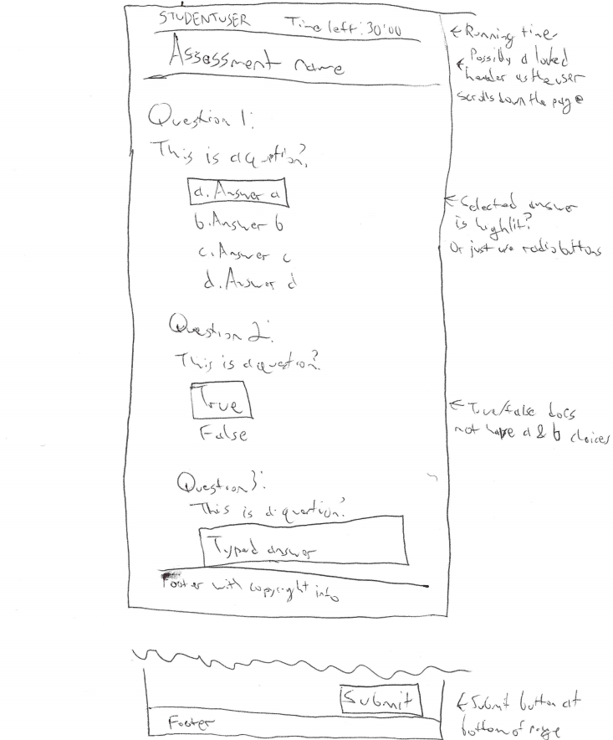
Initial sketch of assessment page

Slide 8
JavaScript Pseudocode
Declare variables for test name, test length (number of minutes), and multi-dimensional test content arrays (for questions and answers)
Assign strings for question text in the first column of the content array
Possibly assign question types (multi-choice, t/f, or typed) to the second column of the content array
Possibly assign the correct answers (a, b, c, d, e, true, false, or a text value) to the third column of the content array
For the multiple choice questions, assign the possible answers in the third and subsequent columns in the content array
Create a function that iterates through a loop to populate the test page with the questions (and possible answers where necessary) from the content array. This will need to get the number of rows in the array for the number of times to loop. It will also need to be able to handle different question types.

Slide 9
JavaScript Pseudocode, cont.
Optional: Create an onmouseover event to highlight the answer that the user is hovering over with their mouse cursor
Optional: Create an onclick event that highlights the answer chosen (or can use radio buttons)
Create a function that checks whether or not the user's answers are correct.
Create a function that calculates the student’s grade.
Optional: Create a function that highlights the correct answer (and, if needed, the incorrect answer that the user chose) for each question (after the user submits the test)
Optional: Implement a timer that ends the quiz when it has expired and submits the form.

Slide 10
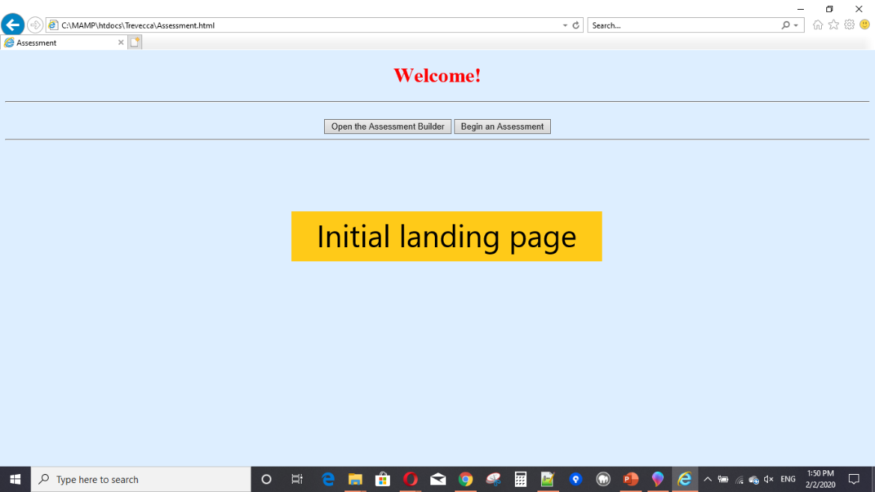
Screenshots: landing page

Slide 11
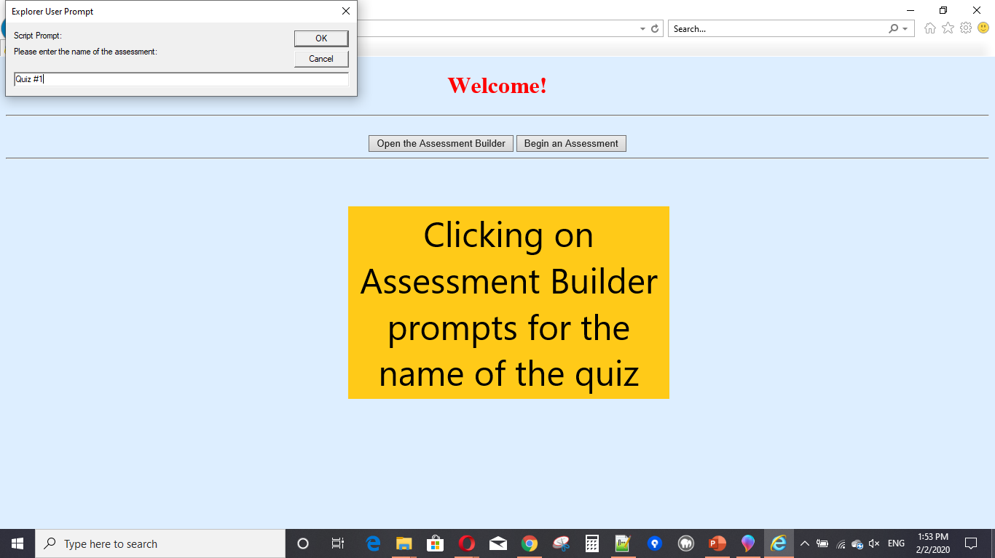
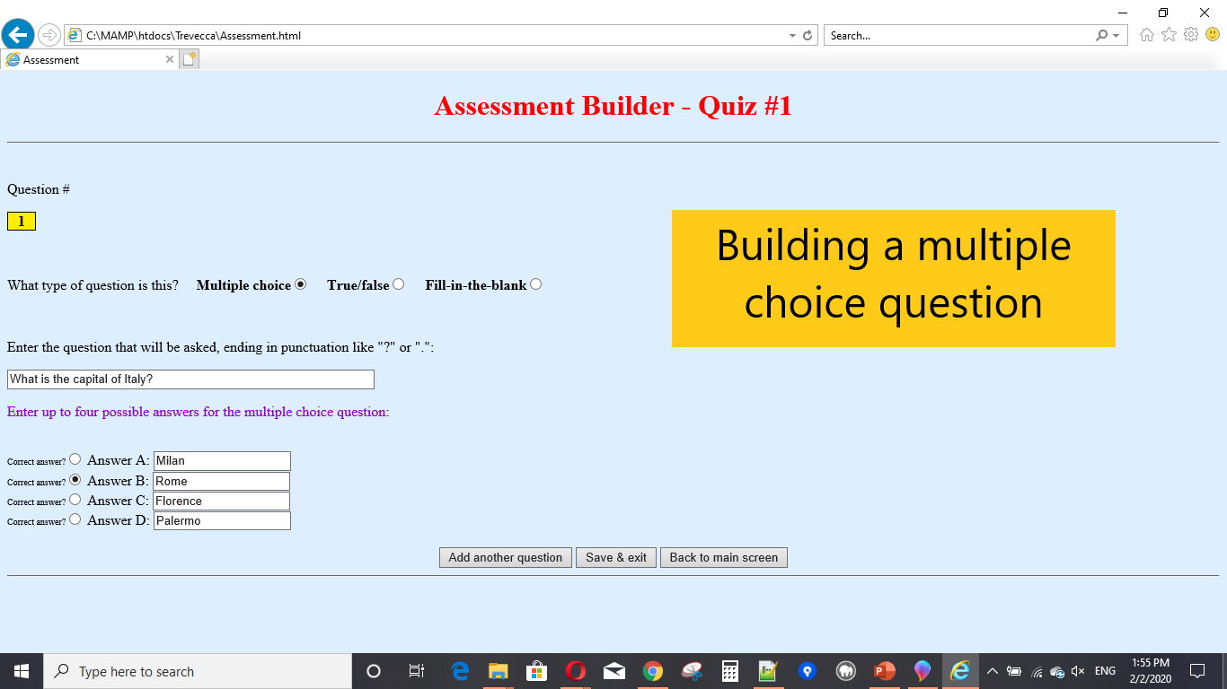
Screenshots: Assessment Builder

Slide 12

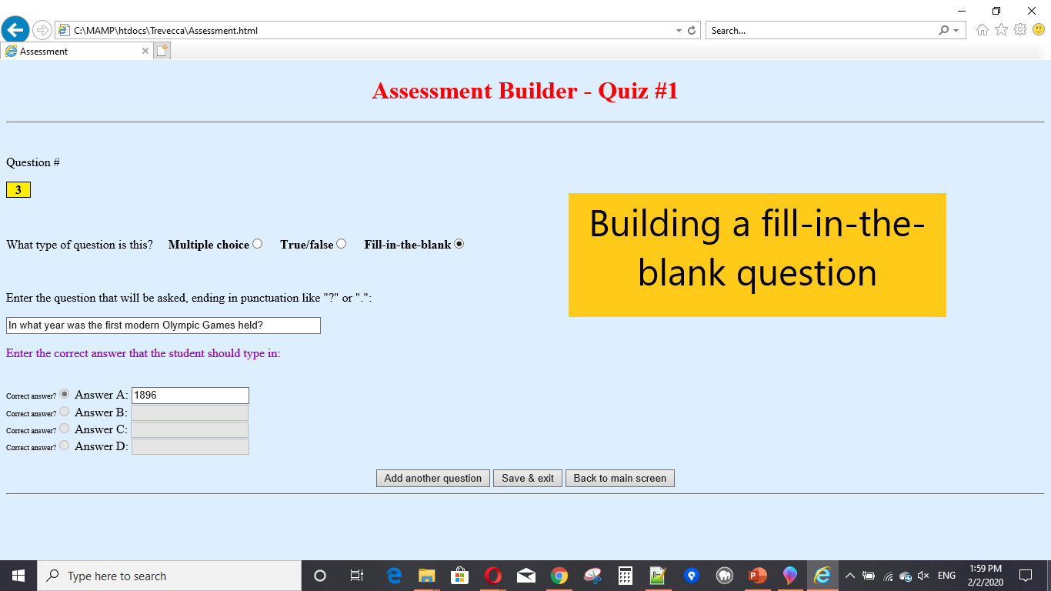
Screenshots: Assessment Builder

Slide 13
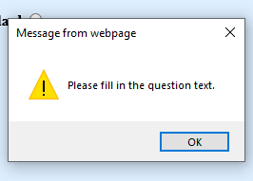
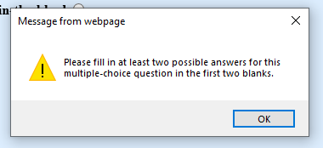
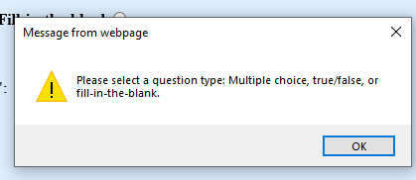
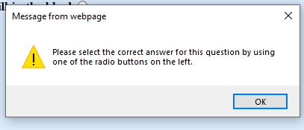
Screenshots: Assessment Builder validation

Slide 14
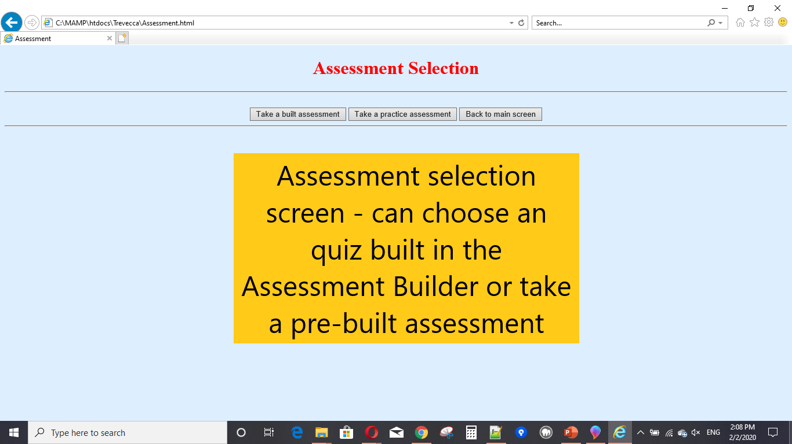
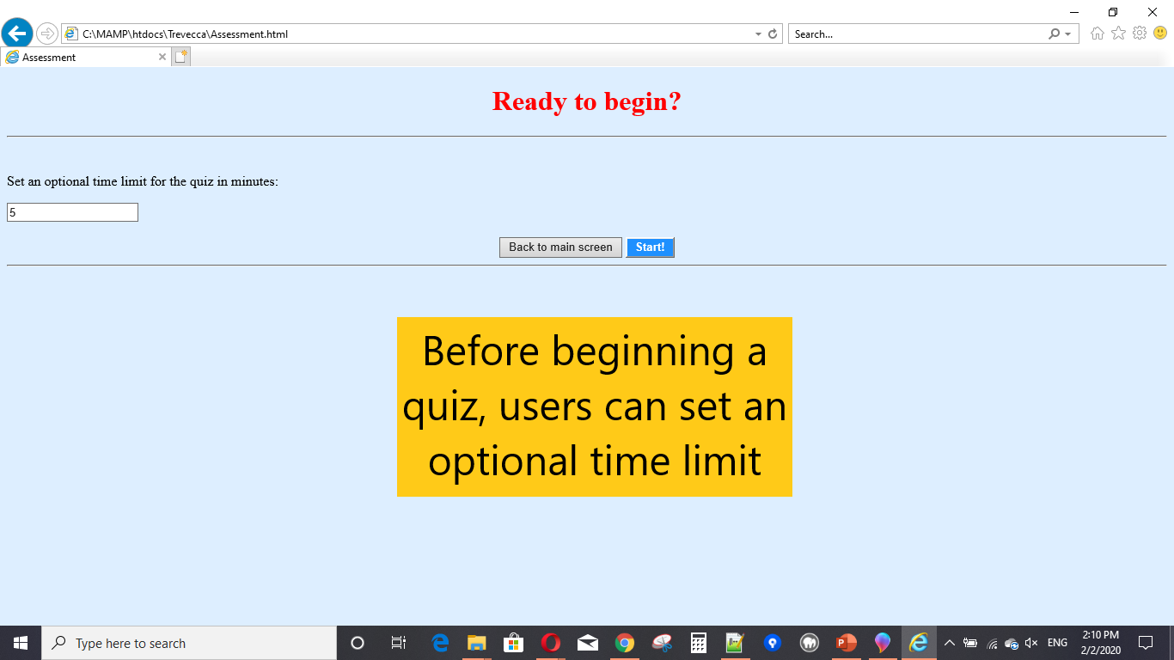
Screenshots: Preparing to take a quiz

Slide 15
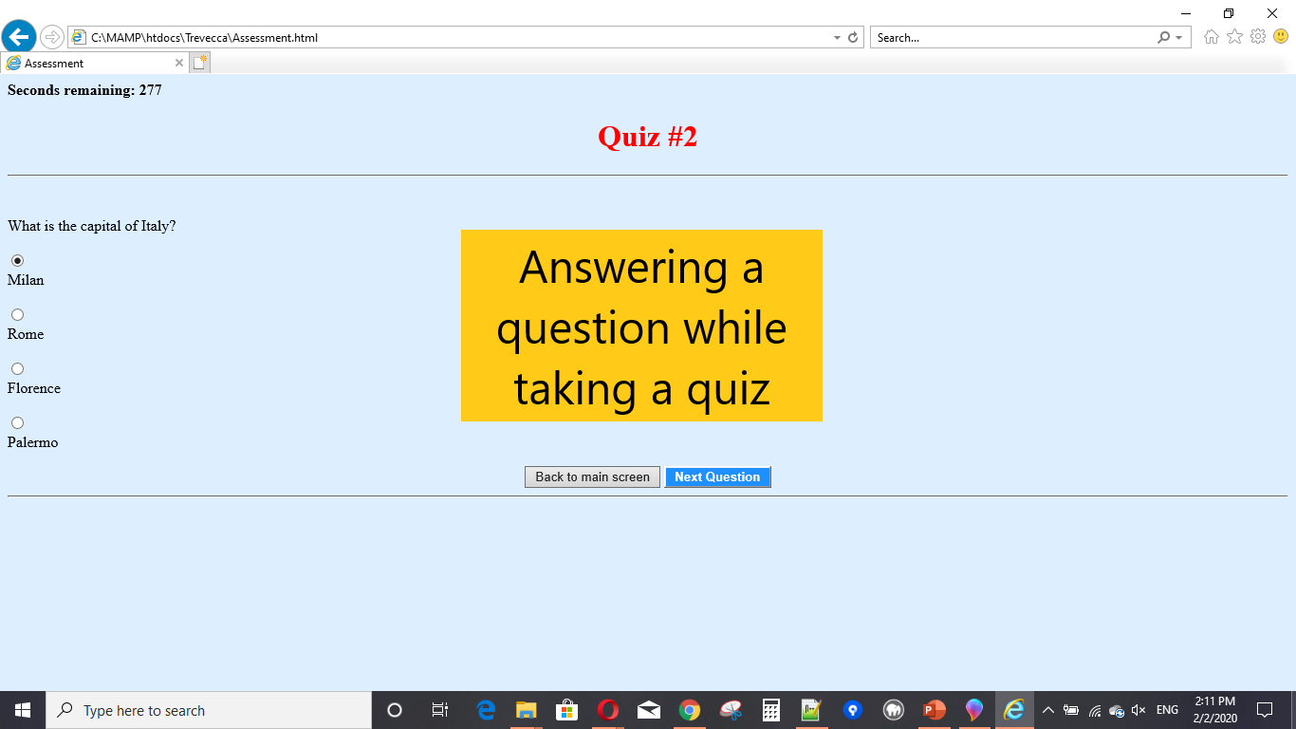
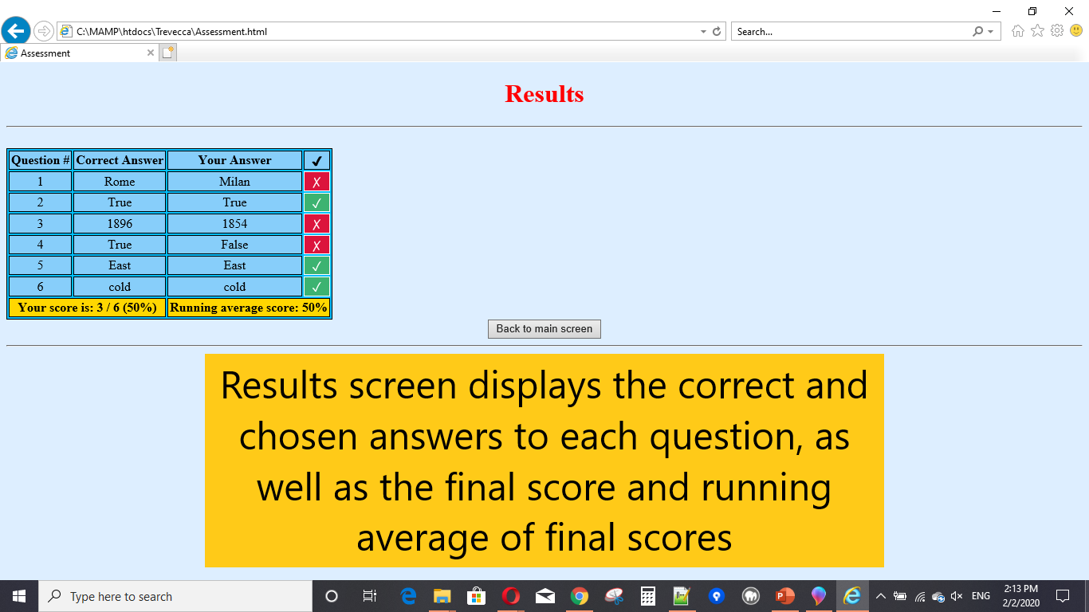
Screenshots: Taking a quiz

